Slide 1

How Robust are Consistency Models?
Instructor: Dr. Mehdi Fardmanesh
fardmanesh@sharif.edu
Supervisor: Dr. Arash Amini
aamini@sharif.edu
Author: MohammadParsa Dini
m.parsa.dini@gmail.com
Student ID: 400101204
1/22

Slide 2
Introduction
The attention to Diffusion models is on the rise on Generative Artificial Intelligence(AI), especially Diffusion Models
The behavior of these models needs to be robust & safe!
Diffusion Models having high computational resources. Consistency Models
We wish to elevate the model against adversarial attacks and also try to make them safe guided
2/22

Slide 3
Overview
1
A brief overview
2
Motives for
Robust Generative
Models
Background &
Literature review
3
4
Our ideas &
Methodology
Conclusion,
Timeline,
References &
Acknowledgements
5
3/22

Slide 4
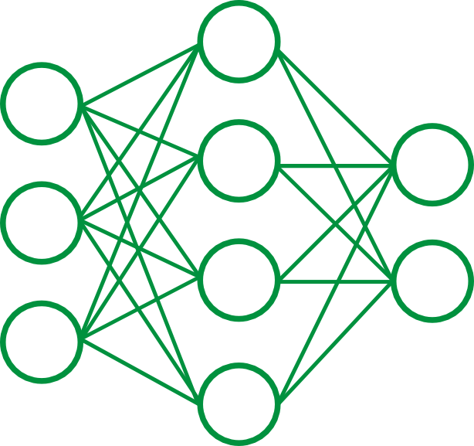



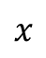

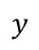
1
Generative AI Acknowledgement
Classic AI Architecture
Generative AI is a type of artificial intelligence that learns patterns in data to create new content that is similar to the original—such as text, images, music, or code.
Examples people use daily: GPT (LLMs), BERT, Stable Diffusion, Speech-to-Text (STT), DALL·E, etc.
Vs. Classic AI (encoder-decoder): Creates vs. predicts.
$$x$$
$$y$$
$$f_{θ}$$
Image 1.1 a simple neural network
https://pyimagesearch.com/2016/09/26/a-simple-neural-network-with
-python-and-keras/
some GenAI models
4/22
Image 1.2 Some Gen AI modles
https://www.redbubble.com/i/sticker/Chat-GPT-3-logo-by-MrShy/135880042.EJUG5

Slide 5
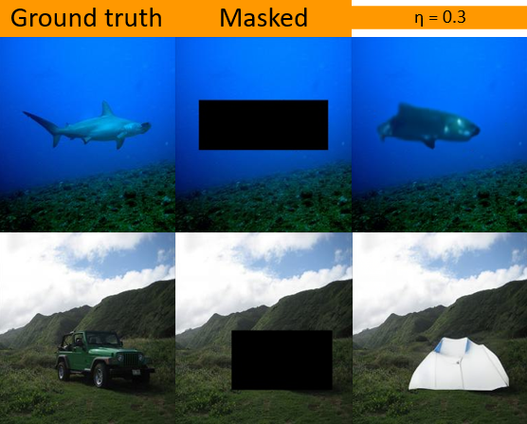
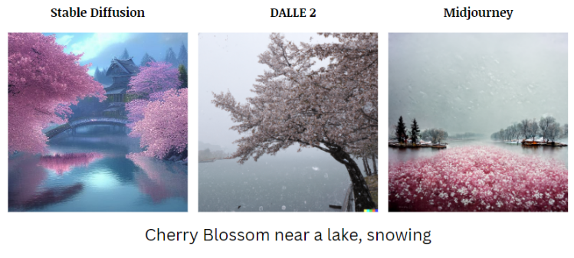
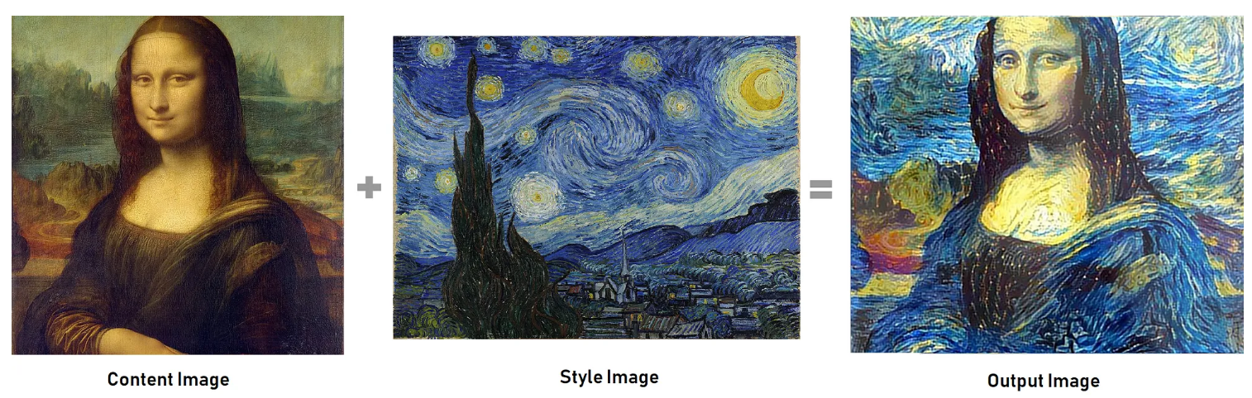
1
Generative AI Acknowledgement
Impainting
Image Generation
Text 2 image
Image 1.3 Impainting Task
Style transfer
Text Generation
Image1.4: Different Text to image model image generation
https://engineering.empathy.co/image-generation-with-ai-models/
5/22
Image 1.5 Style Transfer
https://medium.com/@enoshshr/style-transfer-using-neural-networks-ed62fd1e1dd3

Slide 6
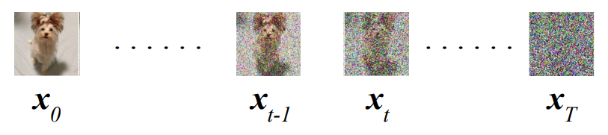
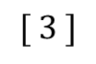
1
How Diffusion Models work?
Passing the image through Consecutive Gaussian Additive
finally reaching Gaussian Distribution.
Then, trying to go back through Gaussian Kernels.
Analogy: Child lost in woods, learning & trying to find home.
Use Markov chains, unlike GANs’ normal sampling.
Guidance in backward process.
$$q\left(x_{t} | x_{t−1}\right)=N\left(x_{t}\right|\sqrt{a_{t}}x_{t−1},(1 − αt)I) (5)$$
$$[ 3 ]$$
Gaussian kernel
Image 1.6 Diffusion Process
https://lilianweng.github.io/posts/2021-07-11-diffusion-models/
6/22

Slide 7
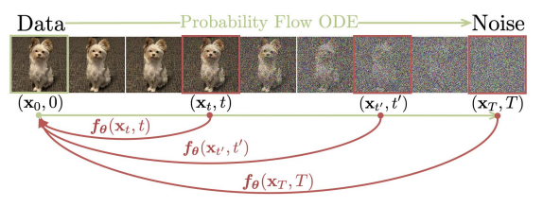
1
Consistency Models(CMs)
CMs are built upon the Probability Flow Ordinary Differential Equations
Bijective mapping between the data distribution and the noise distribution
Consistency condition: all points along a sampling trajectory should map to the same initial data point
CMs can be trained either by distilling pre-trained diffusion models or as standalone generative models.
7/22
Image 2.2 Consistency Process on some image
https://medium.com/@enoshshr/style-transfer-using-neural-networks-ed62fd1e1dd3

Slide 8
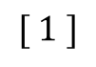
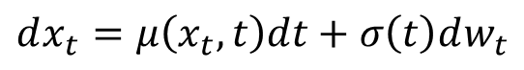
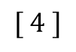
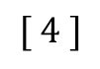
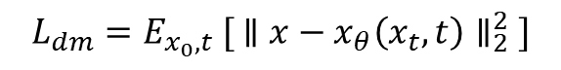
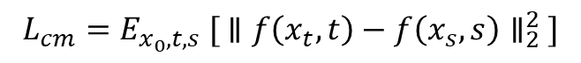
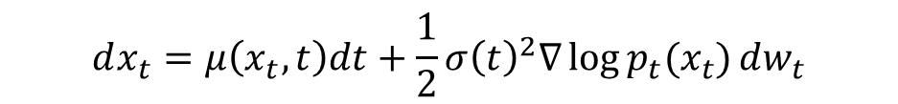
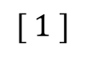
1
CMs v.s. DMs
DM Loss function objective
In Diffusion Models:
$$L_{dm}​=E_{x_{0}​,t} ​[ ∥x−x_{θ}\left(x_{t}​,t\right)∥_{2}^{2} ]$$
$$[ 1 ]$$
$$dx_{t}=μ\left(x_{t},t\right)dt+σ\left(t\right)dw_{t}$$
$$[ 1 ]$$
CM Loss function objective
In Consistency Models:
$$L_{cm}​=E_{x_{0}​,t,s} ​[ ∥f\left(x_{t}​,t\right)−f\left(x_{s}​,s\right)∥_{2}^{2} ]$$
$$[ 4 ]$$
$$dx_{t}=μ\left(x_{t},t\right)dt+\frac{1}{2}σ{\left(t\right)}^{2}∇\log{p_{t}(x_{t})}dw_{t}$$
$$[ 4 ]$$
8/22

Slide 9
Overview
1
A brief overview
2
Motives for
Robust Generative
Models
Background &
Literature review
3
4
Our ideas &
Methodology
Conclusion,
Timeline,
References &
Acknowledgements
5
9/22

Slide 10
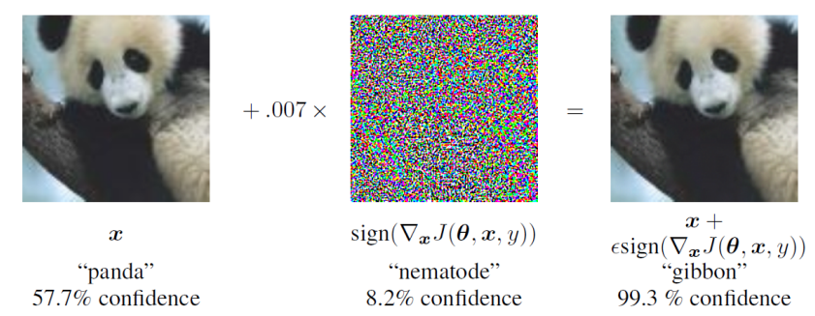
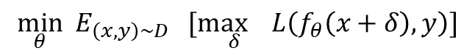
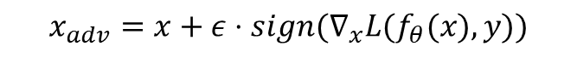
2
Adversarial Attacks in Deep Neural Nets
small, human-imperceptible perturbations can trick neural networks
Objective:
FGSM : With high probability there exists universal perturbations that can fool the model.
PGD: searches locally & capture more
perturbations
$$\min_{θ}​ { E}_{\left(x,y\right)∼D} [\max_{δ}​L\left(f_{θ}​\left(x+δ\right),y\right)]$$
$$x_{adv}=x+ε⋅sign(∇_{x}​L(f_{θ}​(x),y))$$
$$x_{adv}^{t+1}=proj(x_{adv}^{t}+ε⋅sign(∇_{x}​L(f_{θ}​(x_{adv}^{t}),y))$$
10/22
Image 2.1 Misclassification on Deep Neural Networks by additive perturbations
https://arxiv.com/21.3955.788

Slide 11
Overview
1
A brief overview
2
Motives for
Robust Generative
Models
Background &
Literature review
3
4
Our ideas &
Methodology
Conclusion &
References
5
11/27

Slide 12
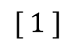
3
Background & Literature Review
Improving Adversarial Attacks on Latent Diffusion Models(LDMs) (ICLR 2024): Attacked latent variables using PGD, showing how adversarial edits propagate through the decoder. Analyzed how encoder-decoder mismatch and attention maps contribute to vulnerabilities.
Adv-Diffusion (CVPR 2024): Used imperceptible latent perturbations to alter face identity while preserving realism.
$$[ 1 ]$$
12/22

Slide 13
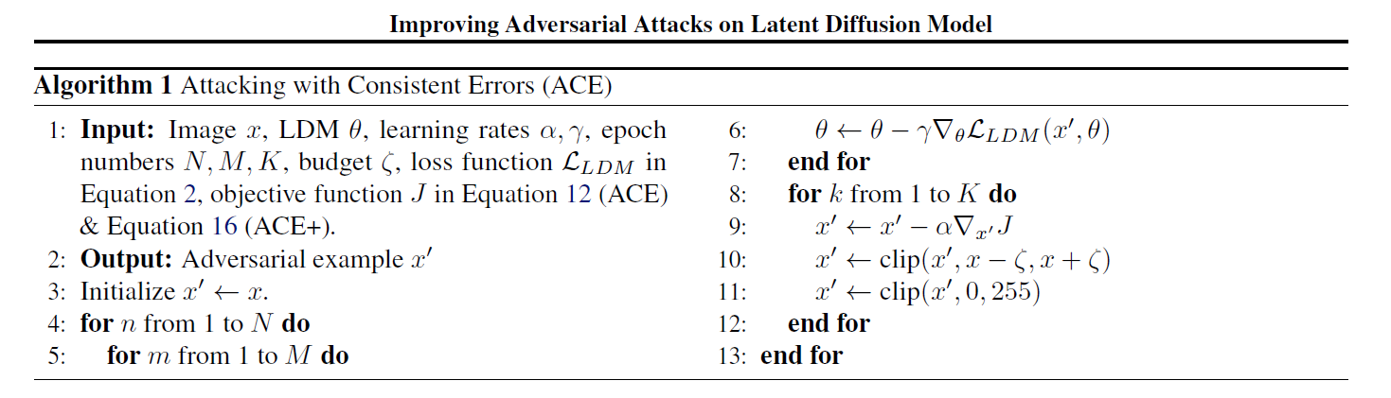
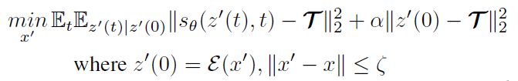
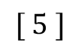
3
Improving Adversarial Attacks on LDMS
algorithm 3.1 Improving Adversarial Attacks on Latent Diffusion Models
https://arxiv.com/21.3955.788
$$[ 5 ]$$
tries to make the denoising direction at every timestep match the target latent T
13/22

Slide 14
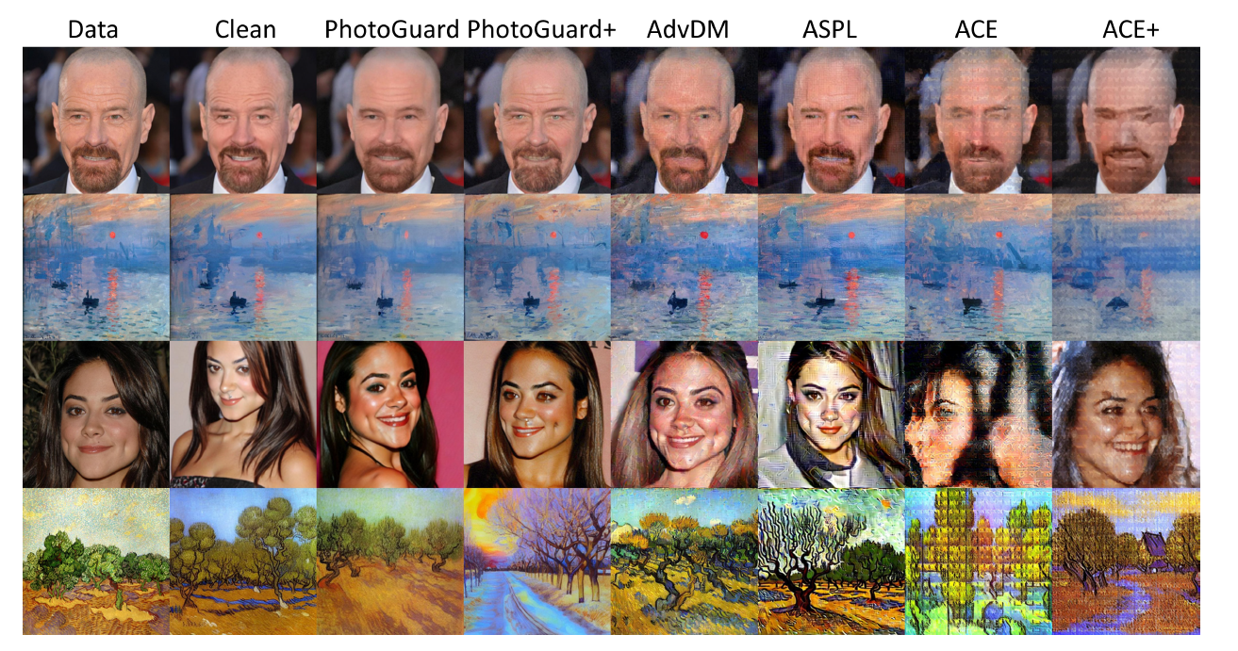
3
Improving Adversarial Attacks on LDMs
Image 3.1 Output images of SDEdit (top two rows) and LoRA (bottom two rows) under different attacks. The adversarial budget is 4/255
https://arxiv.com/21.2652.548
14/22

Slide 15
Overview
1
A brief overview
2
Motives for
Robust Generative
Models
Background &
Literature review
3
4
Our ideas &
Methodology
Conclusion,
Timeline,
References &
Acknowledgements
5
15/22

Slide 16
4
Our ideas
Train a base consistency model
Apply gradient-based attacks: FGSM, PGD on input or noisy latents(inputs)
Analyze output differences (LPIPS, FID)
Introduce & Define an adversarial training for the proposed attack
Analyze how the perturbed input will effect the backward diffusion process?
$$[ 1 ]$$
16/22

Slide 17
Overview
1
A brief overview
2
Motives for
Robust Generative
Models
Background &
Literature review
3
4
Our ideas &
Methodology
Conclusion &
References
5
17/22

Slide 18

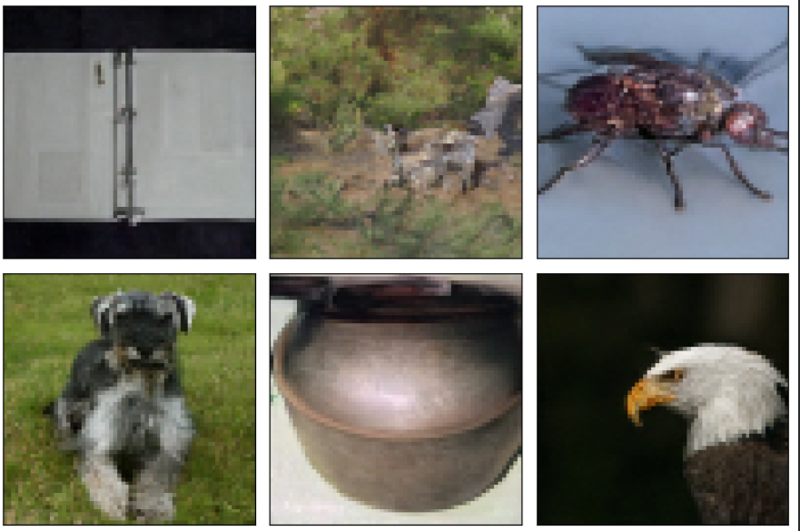
5
Results
Image 5.1
A fooling case using the CM model
Image 5.2
Some images generated by our CM model
18/22

Slide 19
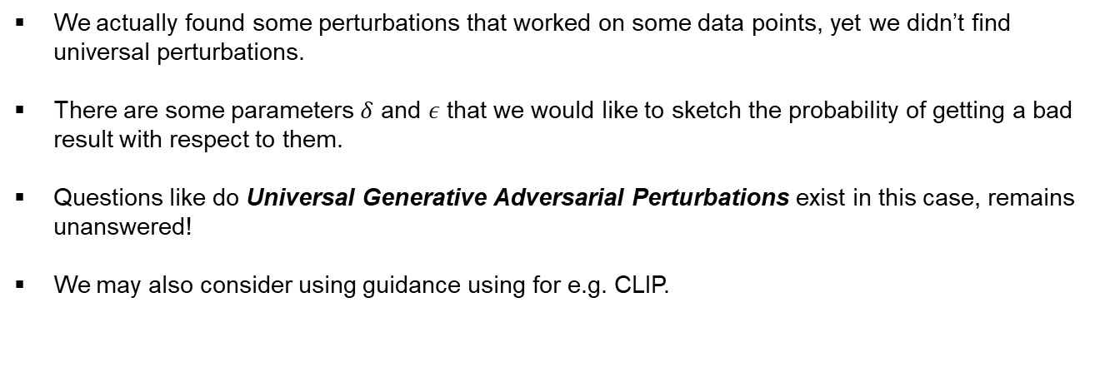
5
Ideas & Expectations
We actually found some perturbations that worked on some data points, yet we didn’t find universal perturbations.
There are some parameters $δ$ and $ε$ that we would like to sketch the probability of getting a bad result with respect to them.
Questions like do Universal Generative Adversarial Perturbations exist in this case, remains unanswered!
We may also consider using guidance using for e.g. CLIP.
19/22

Slide 20
5
Ideas & Expectations
Consistency models represent a powerful class of generative models capable of
producing high-quality, diverse data.
Our idea is to walk through the existing ideas on similar context and see
If they work on consistency models.
20/22

Slide 21
References
Main Sources
[1] J. Ho, A. Jain, and P. Abbeel, "Denoising Diffusion Probabilistic Models,"
arXiv preprint arXiv:2006.11239, 2020. [Online]. Available: https://arxiv.org/abs/2006.11239
[2] Y. Song, P. Dhariwal, M. Chen, and I. Sutskever, "Consistency Models,
" arXiv preprint arXiv:2303.01469, 2023. [Online]. Available:
https://arxiv.org/abs/2303.01469arXiv
[3] D. Liu, X. Wang, C. Peng, N. Wang, R. Hu, and X. Gao, "Adv-Diffusion:
Imperceptible Adversarial Face Identity Attack via Latent Diffusion Model,“
arXiv preprint arXiv:2312.11285, 2023.
[Online]. Available: https://arxiv.org/abs/2312.11285arXiv+1arXiv+1
[4] J. Zhang, Y. Li, and H. Wang, "Improving Adversarial Attacks on Latent
Diffusion Models," arXiv preprint arXiv:2310.04687, 2023.
[Online]. Available: https://arxiv.org/abs/2310.04687arXiv+3arXiv+3Hugging Face+3
21/22

Slide 22
References
Main Sources
[5] J. Ho, A. Jain, and P. Abbeel, "Denoising Diffusion Probabilistic Models,"
arXiv preprint arXiv:2006.11239, 2020. [Online]. Available: https://arxiv.org/abs/2006.11239
[6] Y. Song, P. Dhariwal, M. Chen, and I. Sutskever, "Consistency Models,
" arXiv preprint arXiv:2303.01469, 2023. [Online]. Available:
https://arxiv.org/abs/2303.01469arXiv
[7] D. Liu, X. Wang, C. Peng, N. Wang, R. Hu, and X. Gao, "Adv-Diffusion:
Imperceptible Adversarial Face Identity Attack via Latent Diffusion Model,“
arXiv preprint arXiv:2312.11285, 2023.
[Online]. Available: https://arxiv.org/abs/2312.11285arXiv+1arXiv+1
22/22

Slide 23

18/18

